Slide 1
Software Defined Networks and the
Maturing of the Internet
Nick McKeown
Stanford University

Slide 2

Software Defined Networks and the
Maturing of the Internet
Nick McKeown
Stanford University

Slide 3
Software Defined Network (SDN)
Control
Program
Control
Program
Control
Program
Global Network Map
Control Plane
Control
Packet
Forwarding
Control
Packet
Forwarding
Control
Control
Packet
Forwarding
Packet
Forwarding
Control
Packet
Forwarding

Slide 4
Network Function Virtualization (NFV)
Public Internet
Middlebox
Middlebox
Middlebox
Middlebox
Packet
Forwarding
Packet
Forwarding
Packet
Forwarding
Packet
Forwarding
Packet
Forwarding

Slide 5

Network Function Virtualization (NFV)
Public Internet
VM
VM
VM
Middlebox
Packet
Forwarding
VM
VM
VM
Packet
Forwarding
Packet
Forwarding
Packet
Forwarding
Packet
Forwarding
Packet
Forwarding

Slide 6
“Software will eat the world”
Marc Andreessen

Slide 7

David D. Clark
Chief Protocol Architect, Internet
1981 - 1989

Slide 8
Architectural Principles
Dumb and simple
i
Network: Streamlined, fast, low-cost, easy to maintain, infrequent upgrades.
1

Slide 9
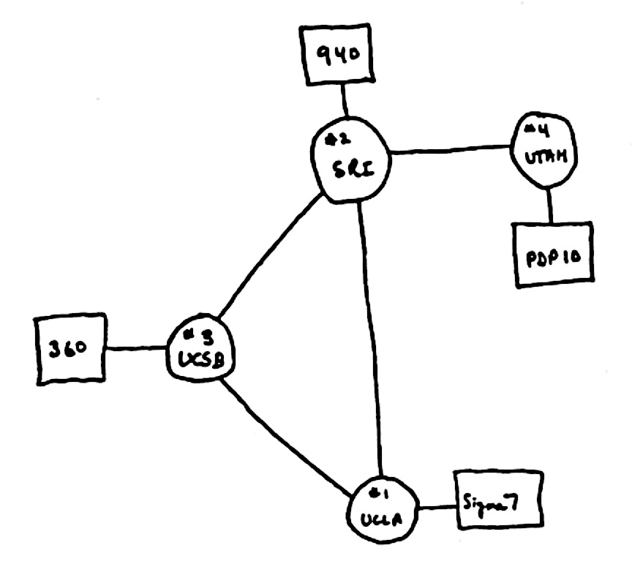
Architectural Principles
Decentralized control
i
Rapid organic growth
2
1969
Notes:
: Four nodes
UCLA, SRI, UCSB, Utah.

Slide 10
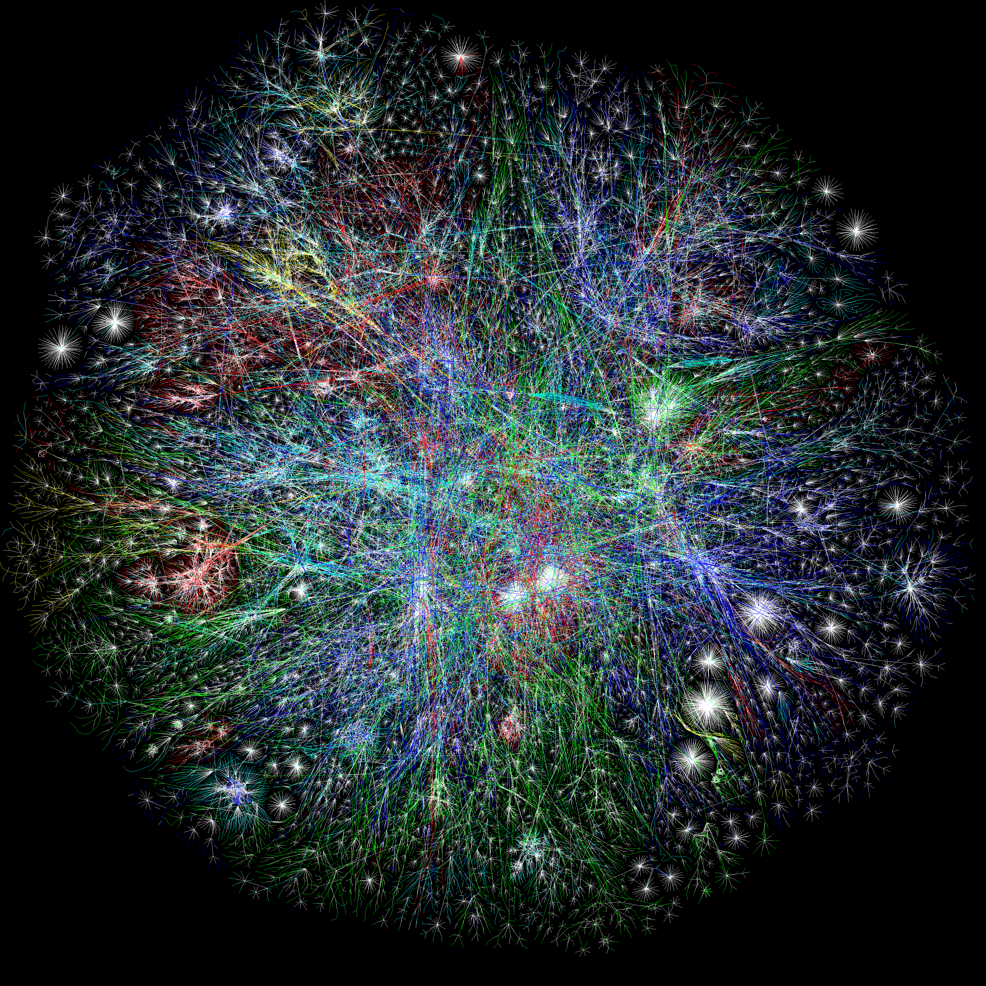
The Opte Project
Notes:
Clearly this is way beyond something a human can do in their head. (Well, me at least – maybe you can).
So we need automated algorithms to calaculate the route and put the necessary fwding entries into the forwarding tables in the routers.
To calculate the routes, the routers will exchange information with each other about the current topology.
This is the job of what we call the Routing Algorithm or the Routing Protocol.
In some cases, the algorithm to calculate the route is wrapped in with the exchange of the state. In other cases, they are separate.
WE will look at both.

Slide 11
The Internet was deliberately designed …
simple and streamlined
To be simple and streamlined.
To have decentralized control: Lots of individually controlled pieces.
Which led to …
Explosive organic growth of the Internet.
A great business for companies selling routers.
A great business
Notes:
About $100B per year. 70% gross profit margin. Which means for every $100 of goods sold, they cost $30 to build. Not bad.
There is a business paradox here. Or rather, the situation is not stable: Simple and Streamlined is at odds with “A great business” <click>
There are two ways to break the instability: Either the Internet becomes a simple and streamlined commodity and is not particularly profitable. This would have been the social good.
Or, we break the simple and streamlined to justify keeping the profit margins high, and keeping others out of the business.
Which would you do if you had a very successful, great business?

Slide 12
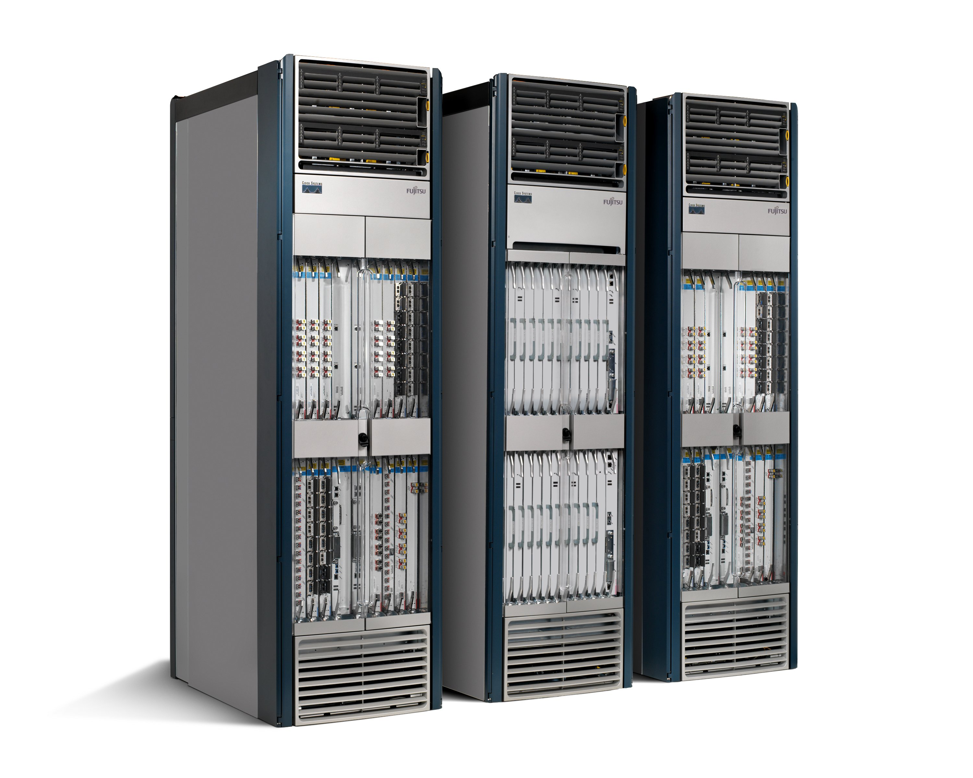
Strategy 1: Vertical integration
Network Management
Proprietary
Features
“CLI”
Proprietary
Operating System
Proprietary
Hardware
Notes:
Vertical Integration: Make sure all the intelligence stays on the box, so you can command a high premium.
Typically a 75% margin business, which means for $1M router, $750k is profit.
One danger: Customers who manage very large networks will start moving the intelligence up into what is usually called “network management”. They will want to do this because:
1. Expertize: Customers operate big networks, so they understand the problems best
2. Differentiate: It allows them to differentiate their network from their competitors.
3. OPEX: They have uniform control over many boxes, from different vendors
4. CAPEX: It reduces cost.
So if you sell routers, you want to make sure that doesn’t happen!
This is true for routers, firewalls and most kinds of middlebox.
For years, the router vendors have made sure the control port is really simple and dumb.
Also called the CLI or command line interface.
Even today, most networks are managed by administrators logging into each router, or at best using screen-scraping to parse the CLI.

Slide 13
Strategy 2: High barrier to entry
Notes:
Once you’ve picked a strategy of vertical integration, the next step is to make no-one else can compete with your vertically integrated box.
The best way is to make sure the development cost is too high. You do this by increasing the number of features you have to support.

Slide 14
Number of published Internet Standards
Notes:
First one published April 7, 1969
Many of these are written and published by the router companies themselves…..

Slide 15
Proprietary
Features
50+ million lines of code
Proprietary
Operating System
Proprietary
Hardware
Tens of billions of gates
Routers are fragile, insecure, bloated and power hungry.
Like computer mainframes in the 1980s.
“Great business” triumphed over “simple and streamlined”.
Notes:
The consequence: Routers bloated, expensive, fragile and insecure….
We can argue about the details; but it couldn’t be any other way, because the market is making it so.
So what to do?

Slide 16
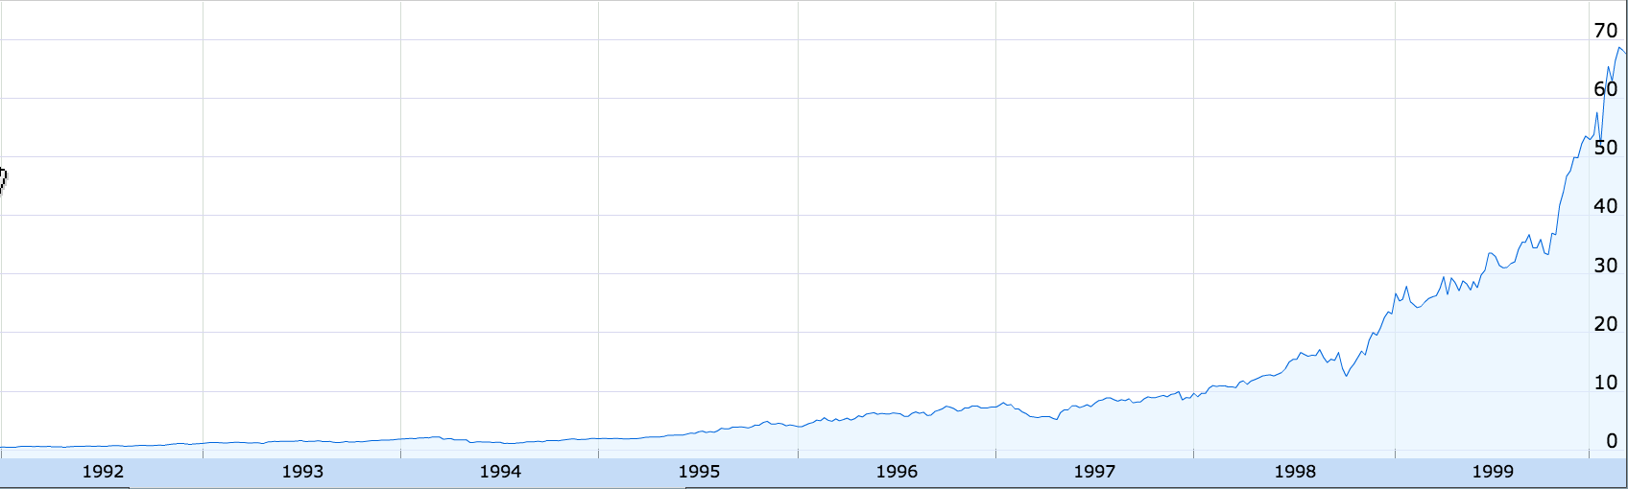
Cisco Stock Price
200x
1991
1999
Google Finance

Slide 17
How Data Center Owners Responded

Slide 18
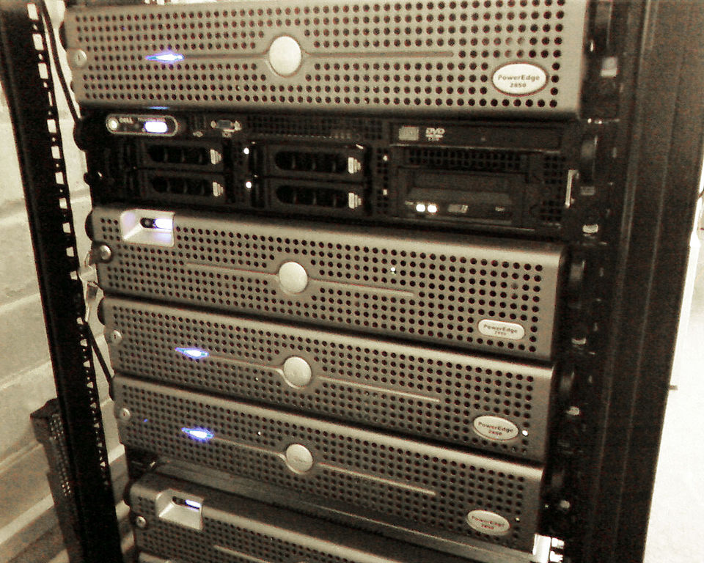
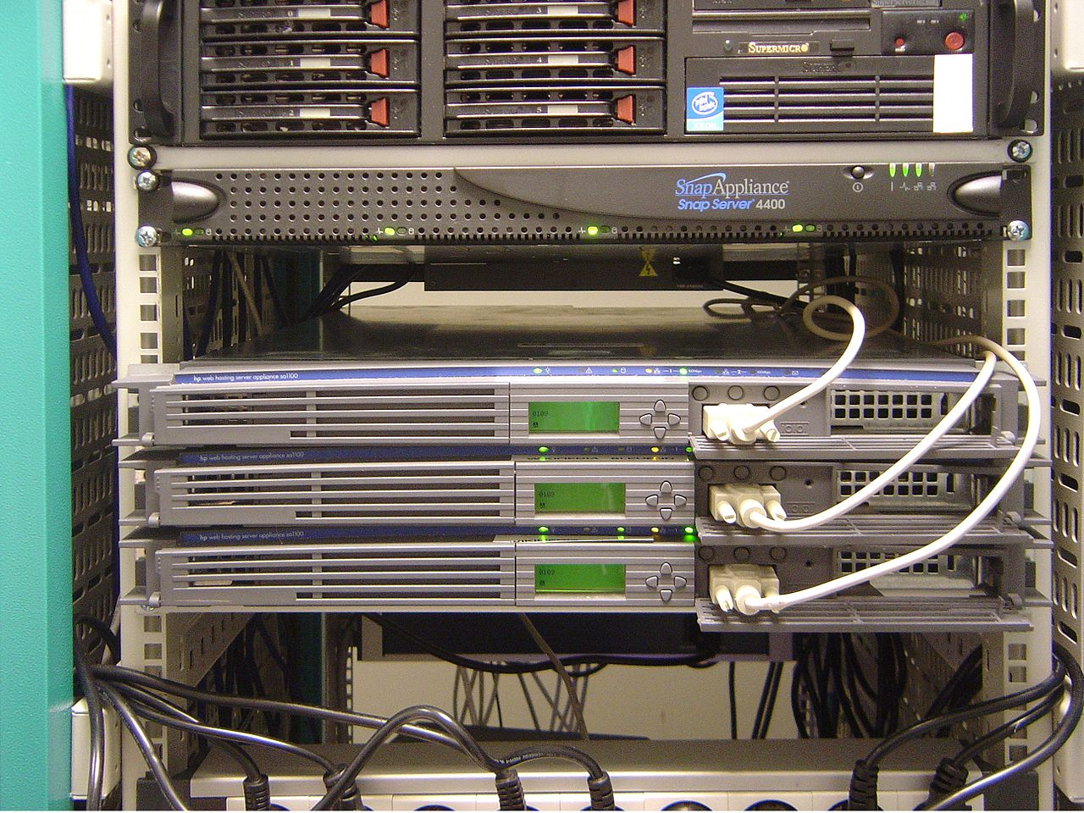
2000: Rack-mounted Servers
Dell Servers
HP Servers

Slide 19
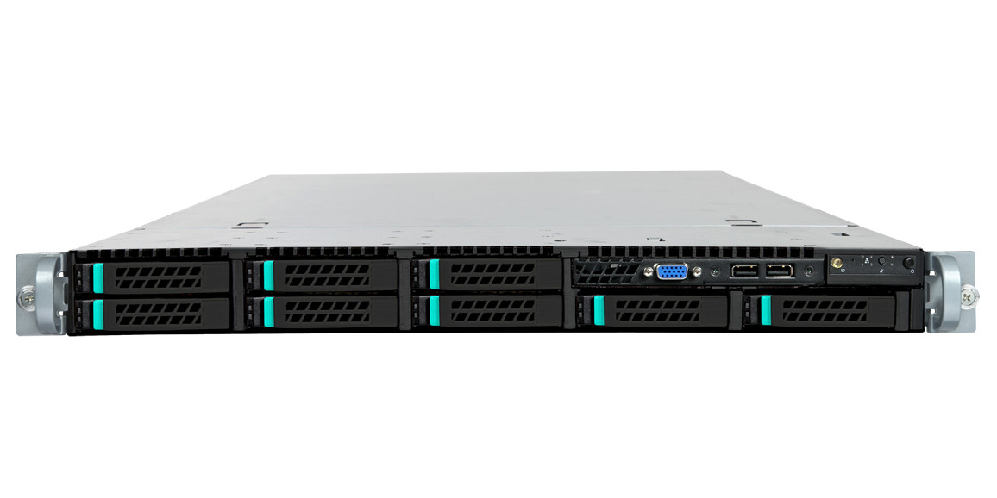

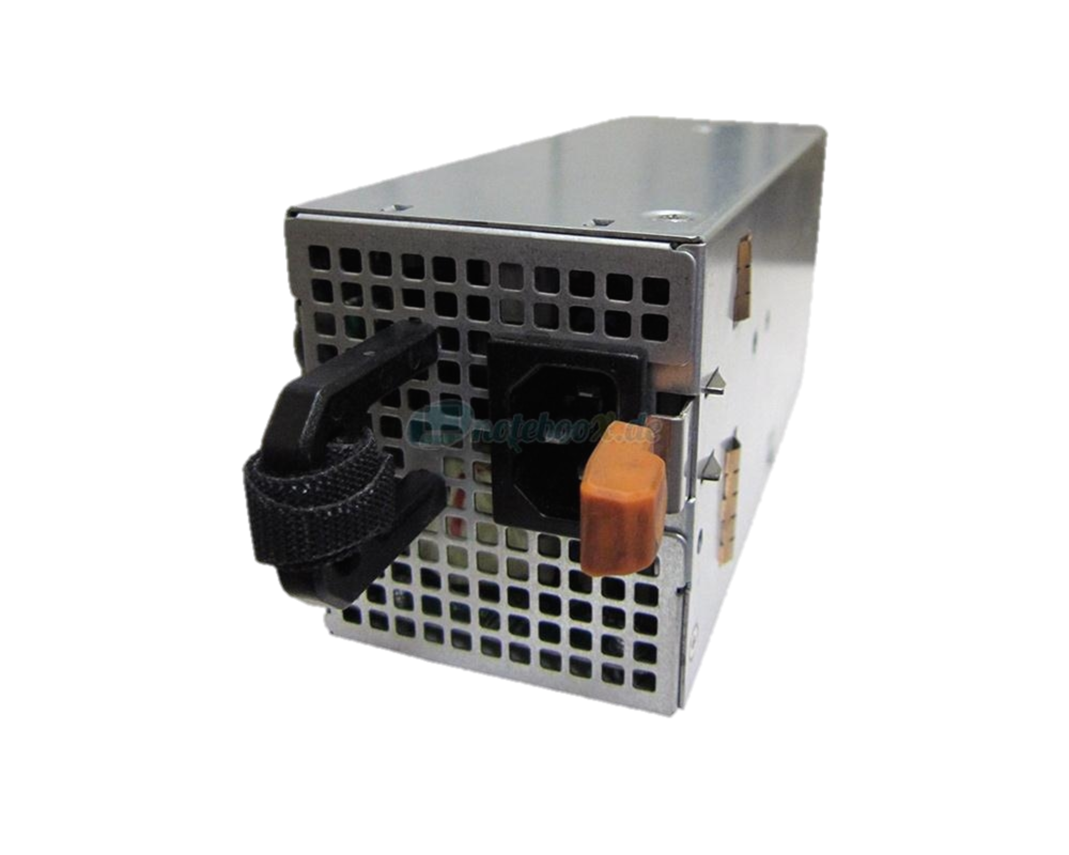

2005: The baremetal server
Linux
Sheet metal
CPU
DRAM
Power supply + fans
Notes:
2.5Billion transistors --- 100,000 times bigger. 4GHz --- 10,000 times faster
Taiwan

Slide 20
Baremetal + Linux + Apps
App
App
App
Proprietary
Software
Open-source
Software
Linux
Sheet metal
Programmable
Hardware
CPU
DRAM
Power supply + fans
Notes:
2.5Billion transistors --- 100,000 times bigger. 4GHz --- 10,000 times faster
Taiwan

Slide 21
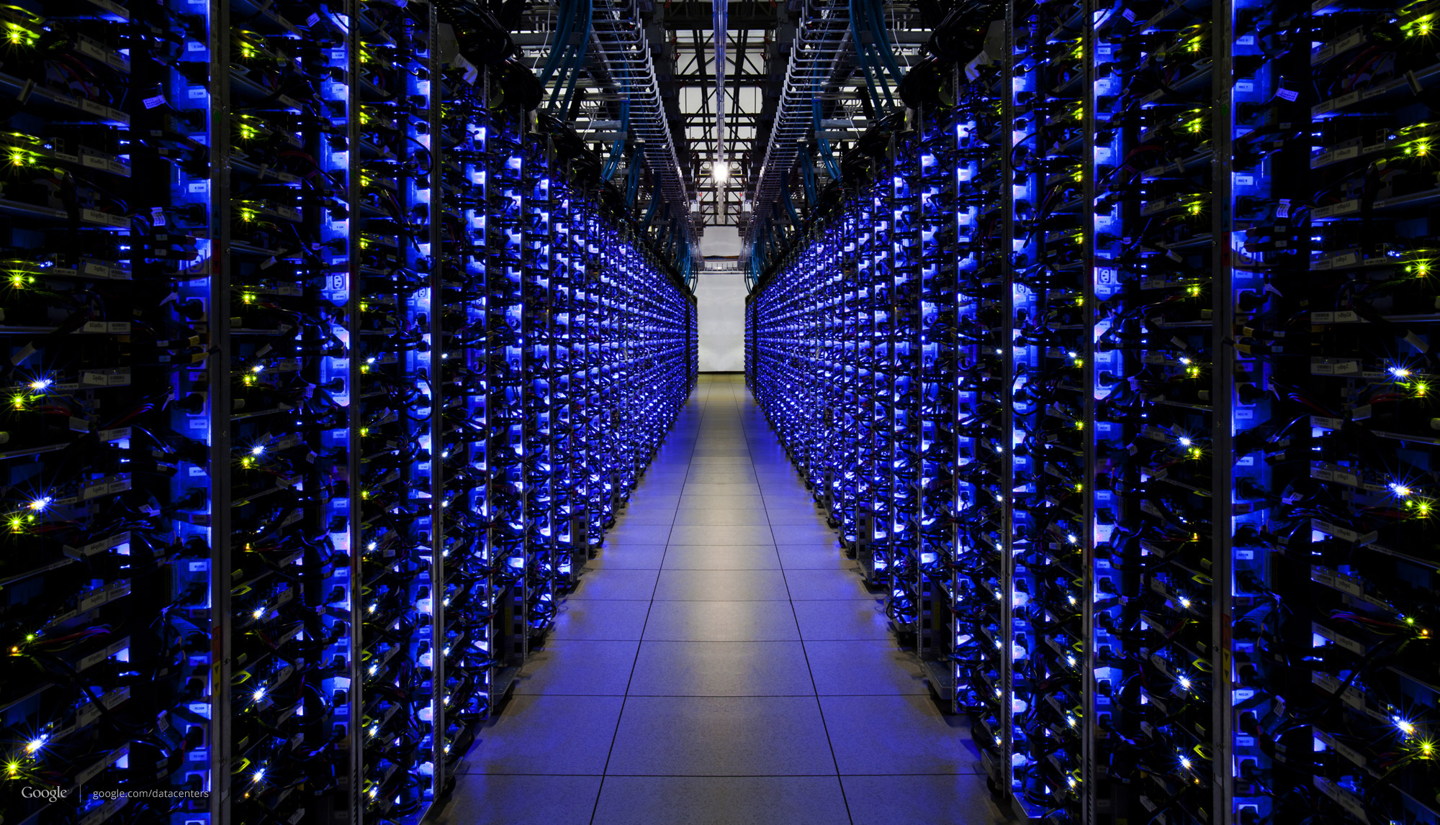

Slide 22
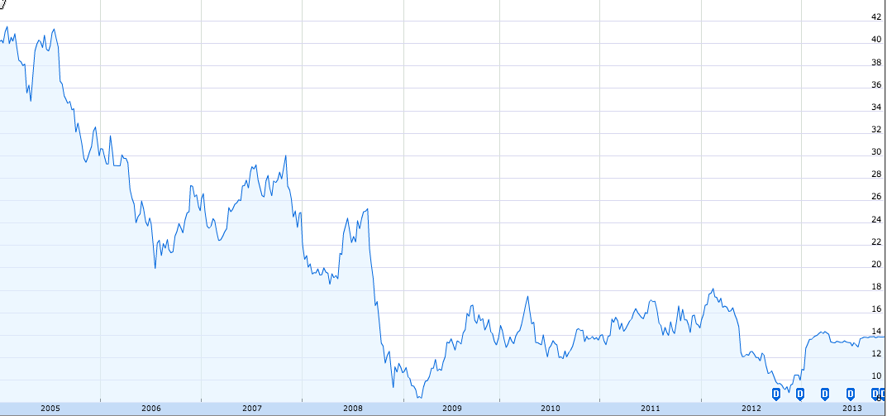
Dell Stock Price
$42
$14
2005
2013
Google Finance

Slide 23
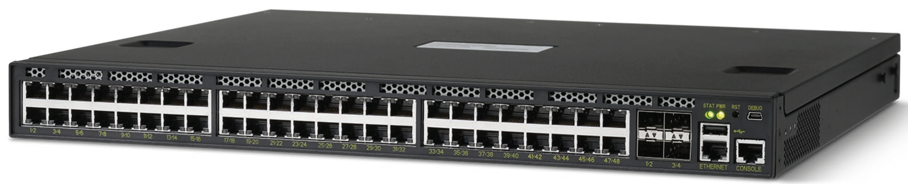
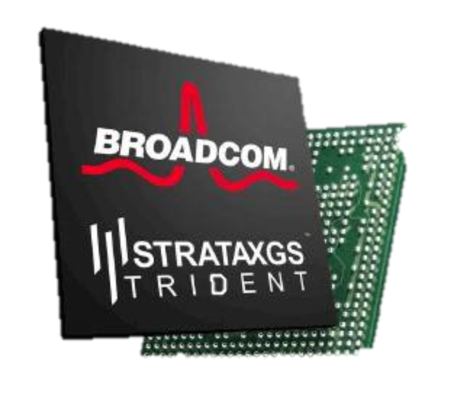
2012: The baremetal switch
Linux
Sheet metal
CPU
DRAM
xChip
Power supply + fans
Notes:
2.5Billion transistors --- 100,000 times bigger. 4GHz --- 10,000 times faster
Taiwan

Slide 24
Baremetal + Linux + App
App
App
App
Proprietary
Software
Open-source
Software
Linux
Sheet metal
Open-source
P4
Programmable
Hardware
CPU
DRAM
xChip
Power supply + fans
Notes:
2.5Billion transistors --- 100,000 times bigger. 4GHz --- 10,000 times faster
Taiwan

Slide 25
It’s happening fast!

Slide 26
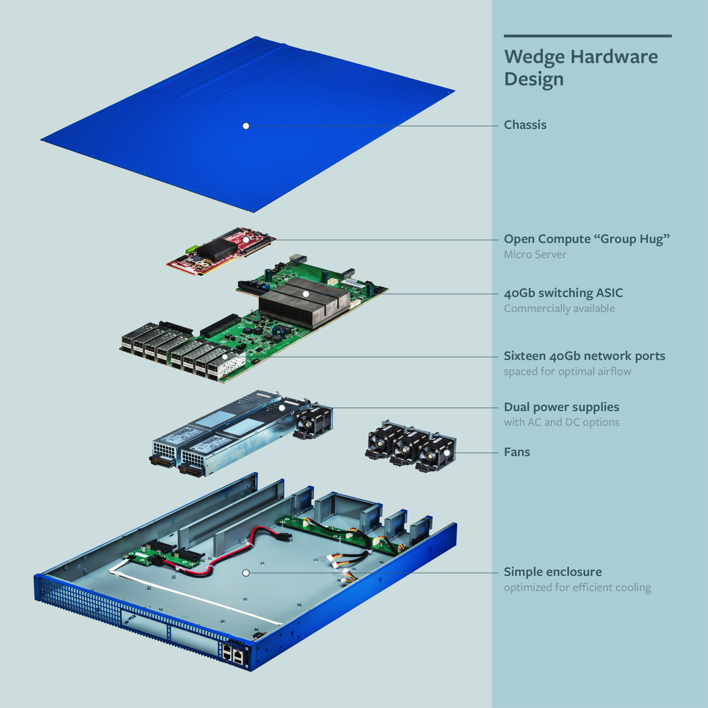
OCP: Wedge switch (open-source design)
BCM xChip: 1.2Tb/s

Slide 27
App
App
App
Proprietary
Software
Open-source
ONOS, ODL
NOX, POX, Ryu
Floodlight, Beacon
Network Controller
Optional Remote API
Open-source
FBOSS, OVS, Indigo, SwLight.
Forwarding Agent
Open-source
ONL
Linux
Open-source
OF-DPA
Open-source
ONIE
API/Driver
Boot Loader
Open-source
P4
CPU
DRAM
xChip
Power supply + fans
Notes:
2.5Billion transistors --- 100,000 times bigger. 4GHz --- 10,000 times faster
Taiwan

Slide 28
Big data centers use baremetal switches
Cost
400,000 servers
20,000 switches
$5k vendor switch = $100M
$1k bare-metal switch = $20M
Savings in 10 data centers = $800M
Control
Tailor network to applications
Proprietary behavior
Quickly debug

Slide 29
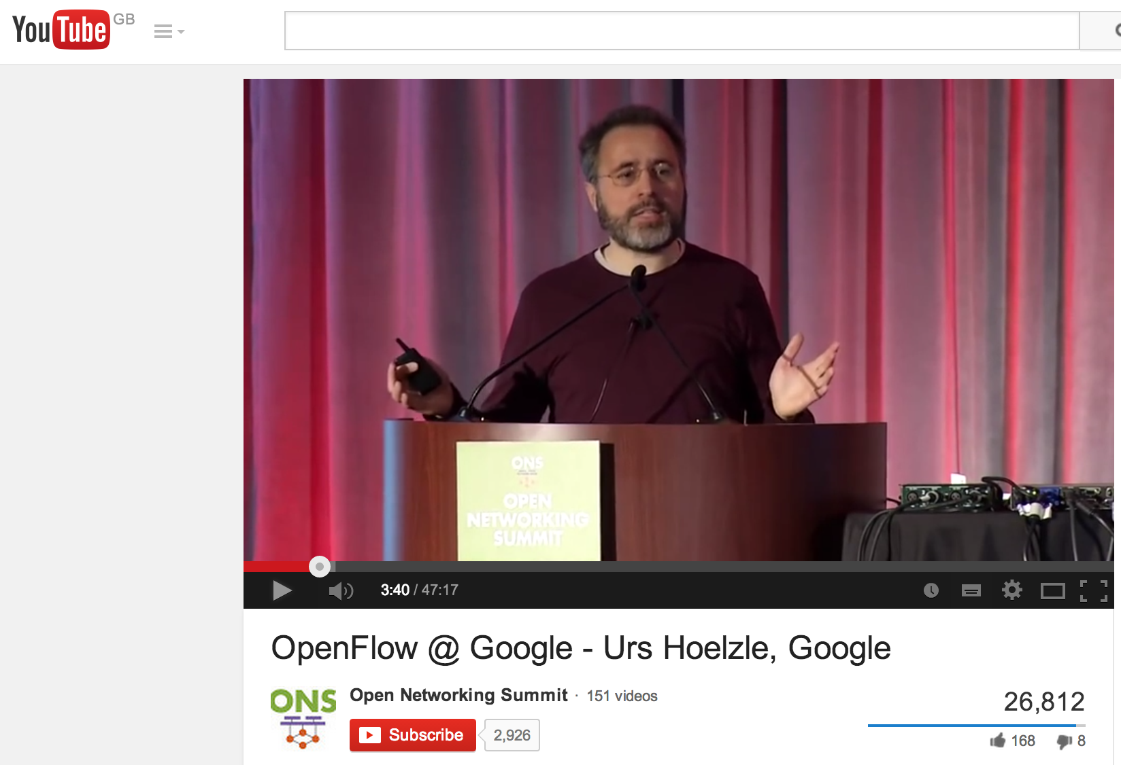
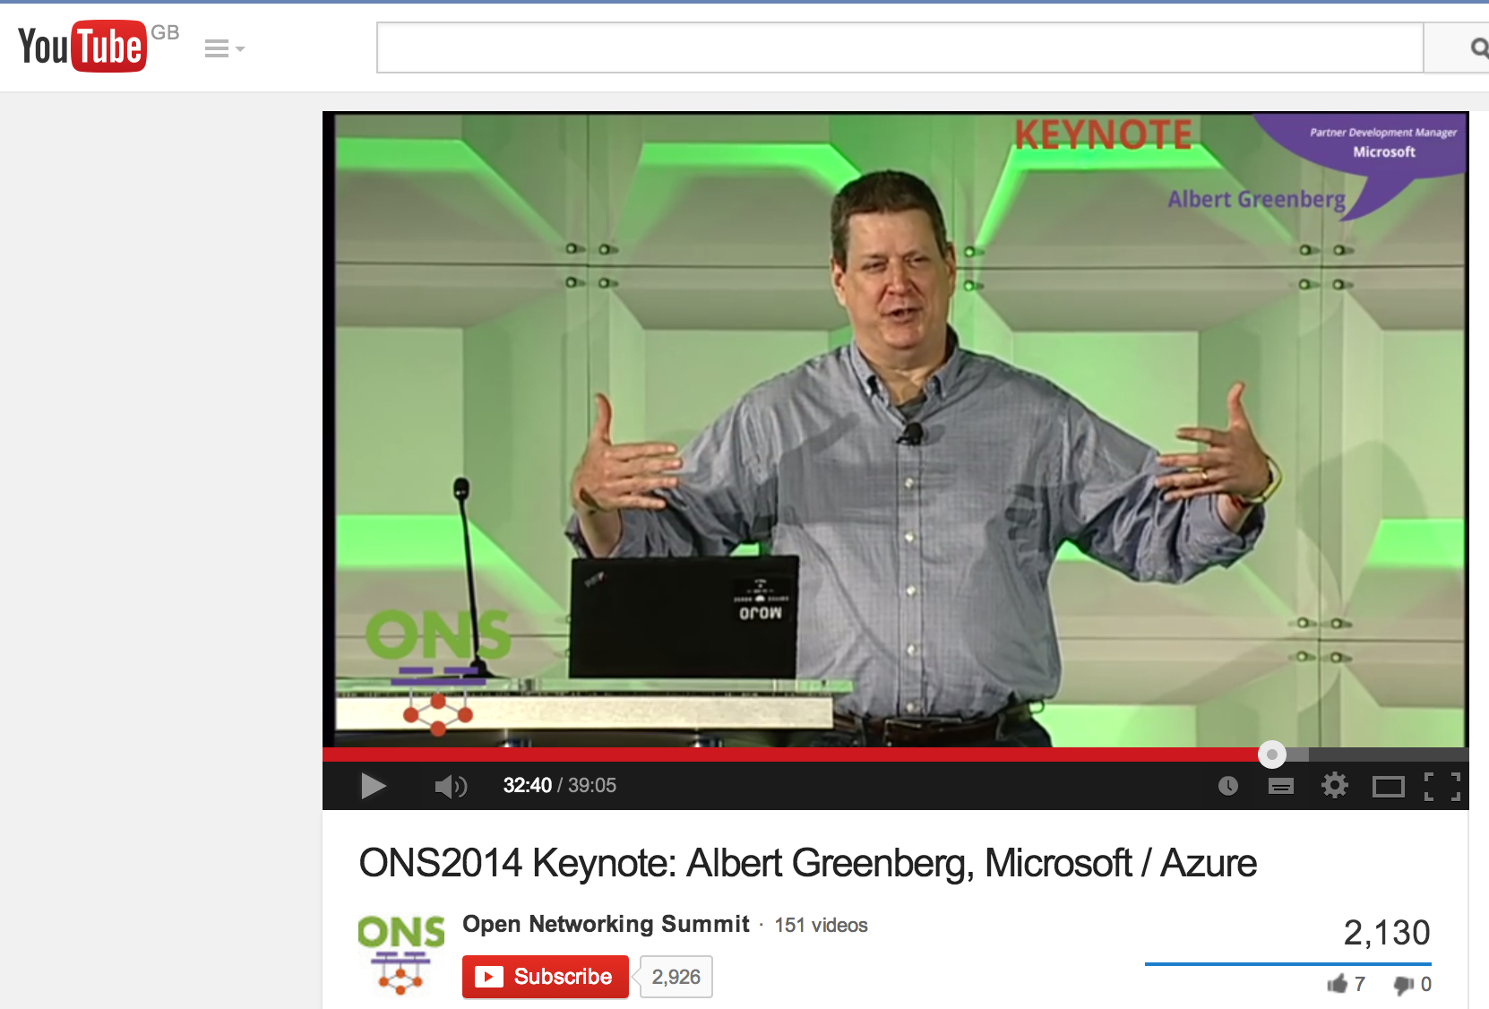
Two great explanations
Google
Microsoft

Slide 30
Now ISPs and Telcos are Starting to Respond

Slide 31
The Problem
Global IP traffic growing 40-50% per year
End-customer monthly bill remains unchanged
Therefore, cost of ownership needs to reduce 40-50% per Gb/s per year
But in practice, reduces by <20% per year
Revenue
$30/month
Total cost
Growth in traffic
time

Slide 32
Baremetal + Linux + Apps
Reduce capital cost
  Move to baremetal switches + Linux
Reduce operational cost
  Streamline protocols, features and software
Increase price
  Differentiate with new proprietary software services

Slide 33


Baremetal + Linux + Application
Baremetal
xChip/x86 + Linux/BSD
Public Internet
Telcos/Cable
ARM + Linux
Open
Connect
Netflix
Compute:
Baremetal
x86 + Linux
(10 million/yr)
YouTube
Google Fiber
B4
Facebook
Google WiFi
Network:
Baremetal
xChip/x86 + Linux
(500 thousand/yr)
Search
Swan
Amazon
Notes:
It’s the way the whole industry it headed….

Slide 34
On SDN
“Because there is no army that can hold back an economic principle whose time has come.”
John Donovan, AT&T (2014)
Cisco 2014
  #1 Competitor: A software company (VMware)
  #1 Fear: Baremetal switches
Notes:
Creation of ONF: Move to baremetal switches + open-source software, controlled by ISPs and data center owners.
Domain 2.0: Moving $21B of capex per year towards SDN and NFV. More than all the big 4 DC combined

Slide 35
Overall System Management
Routing, Traffic Engineering,
Mobility, VPN
DPI, Load Balance, SPAM
New Services
Proprietary
Software
Remote Control Plane
Open Source
Software
Linux
Linux
Linux
Linux
Linux
Programmable
Hardware
Server
Switch
Radio
PIC
VM

Slide 36
Notes:
20minutes

Slide 37
SDN and NFV inevitable because…
Rise of Linux.
Rise of baremetal servers and switches.
NFV: Rise of virtualization.
SDN: Rise of merchant switching silicon.

Slide 38
How switching chips are evolving

Slide 39
Today: Fixed function switches
L3: 16k x 32
Longest prefix
match
L2: 128k x 48
Exact match
ACL: 4k
Ternary match
Etc.
L2 Stage
L3 Stage
ACL Stage
…
Queues
In
Parser
Action: set L2D
Action: set L2D, dec TTL
Action
Out
Header
L2 Table
L3 Table
ACL Table
Match
Action: permit/deny
Data
Header
Combine
Stage 1
Stage 2
Stage 3
Stage 16
Data
Data

Slide 40
Packet Forwarding Speeds
3.2Tb/s
Gb/s
(per chip)

Slide 41
Packet Forwarding Speeds
3.2Tb/s
50x
Gb/s
(per chip)

Slide 42
Why the difference
Packet processing is inherently parallel
  Packets from different interfaces can be processed at same time
  Deep pipelines
Switching chips are dominated by I/O
  3.2Tb/s = 128 x 25Gb/s serial I/O

Slide 43
Switch chips
Lots of Serial I/O
(10Gb/s or 25Gb/s)
Memory
(match tables and packet buffers)
Wires
(pipeline busses)
Logic
(everything else)
Notes:
About 50% of area on serial I/O, 25% on memory, everything else is wire and logic.
About 4M transistors per sq mm today – logic is “free”.

Slide 44
Problems: Fixed function switching chips
Slow innovation
Several years to add a new feature or protocol
Inefficient
Match tables hard-wired to specific purpose
Complicated
Switch implements superset of all features
Leads to bottom-up design
Frustrating for programmers

Slide 45
Switch OS
Run-time API
“This is how I process packets”
(Datasheet)
Fixed-function ASIC

Slide 46
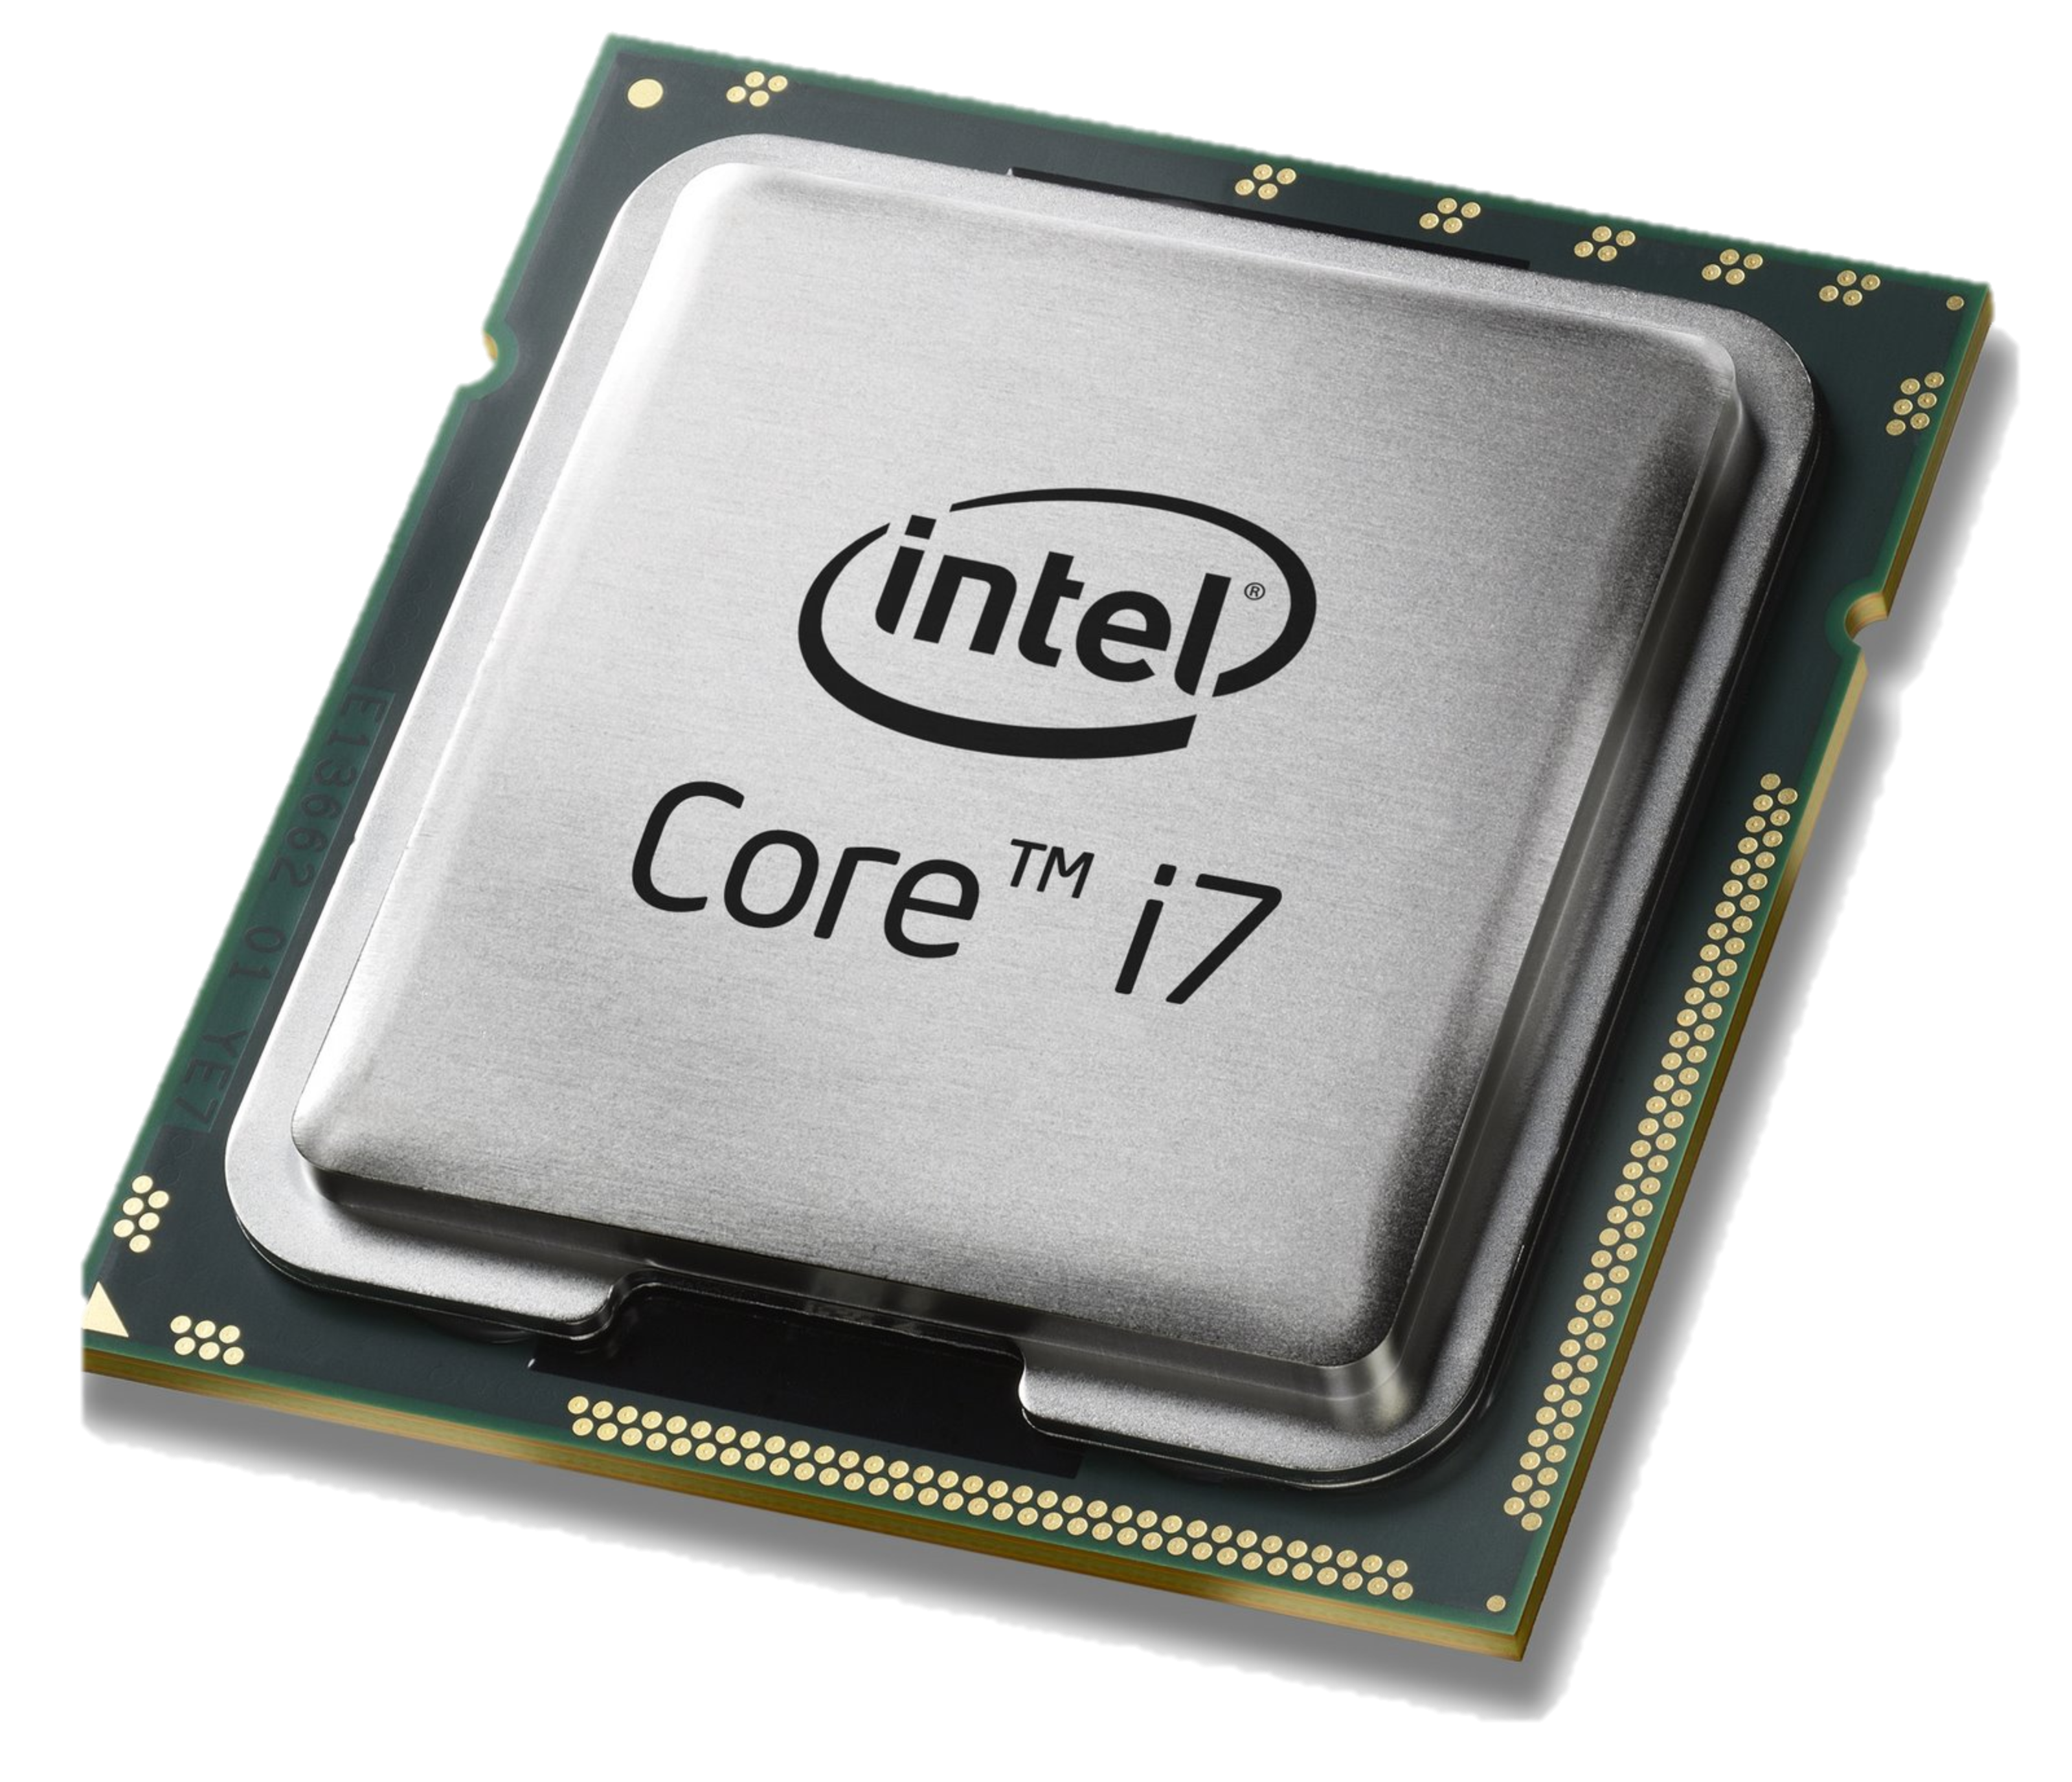
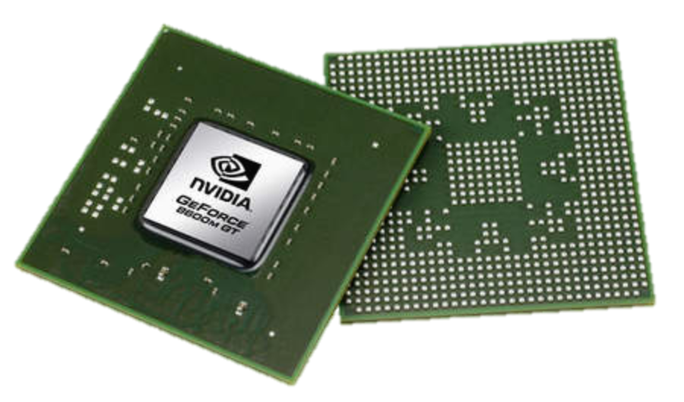
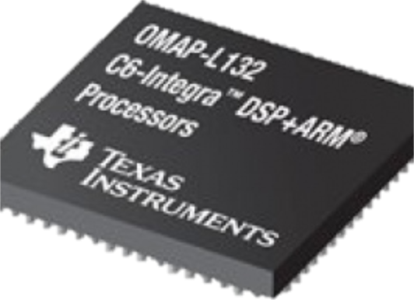
Software Defined Everything
Cellular
Base Stations
Networks
Computers
Graphics
App
App
App
App
Compiler
Compiler
Compiler
Compiler
?
CPU
GPU
DSP

Slide 47
The RMT Architecture
Protocol independence
Initially, switch chip is unprogrammed.
It does not know any protocols.
It does not know how to forward packets.
Parser
Ingress Match+Action
Queues
Egress Match+Action
Notes:
Chip design dominated by:
I/O
Memory
Wire
(Logic is almost free)

Slide 48
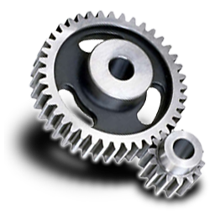
dc.p4
1
(P4 code)
Protocol
Authoring
2
Compile
Compiler
Eth
VLAN
3
Configure
IPv4
IPv6
TCP
New
Parser
Ingress Match+Action
Queues
Egress Match+Action

Slide 49
dc.p4
Switch OS
1
4
(P4 code)
Protocol
Authoring
Run!
Add/delete table rules
2
Compile
Compiler
Run-time API
3
Configure
Parser
Ingress Match+Action
Queues
Egress Match+Action
Eth
VLAN
IPv4
IPv6
TCP
New

Slide 50
Switch OS
“This is how the switch must
process packets”
(Program)
Run-time API
The P4 Programming Language
(www.p4.org)
Programmable switch

Slide 51
Observations about switch chips
Chip design dominated by: (1) I/O, (2) Memory, (3) Wire.
There is no power, performance or area penalty for programmability
The fastest switching chips will be programmable
In private networks, “standard protocols” will be replaced by “programs”

Slide 52
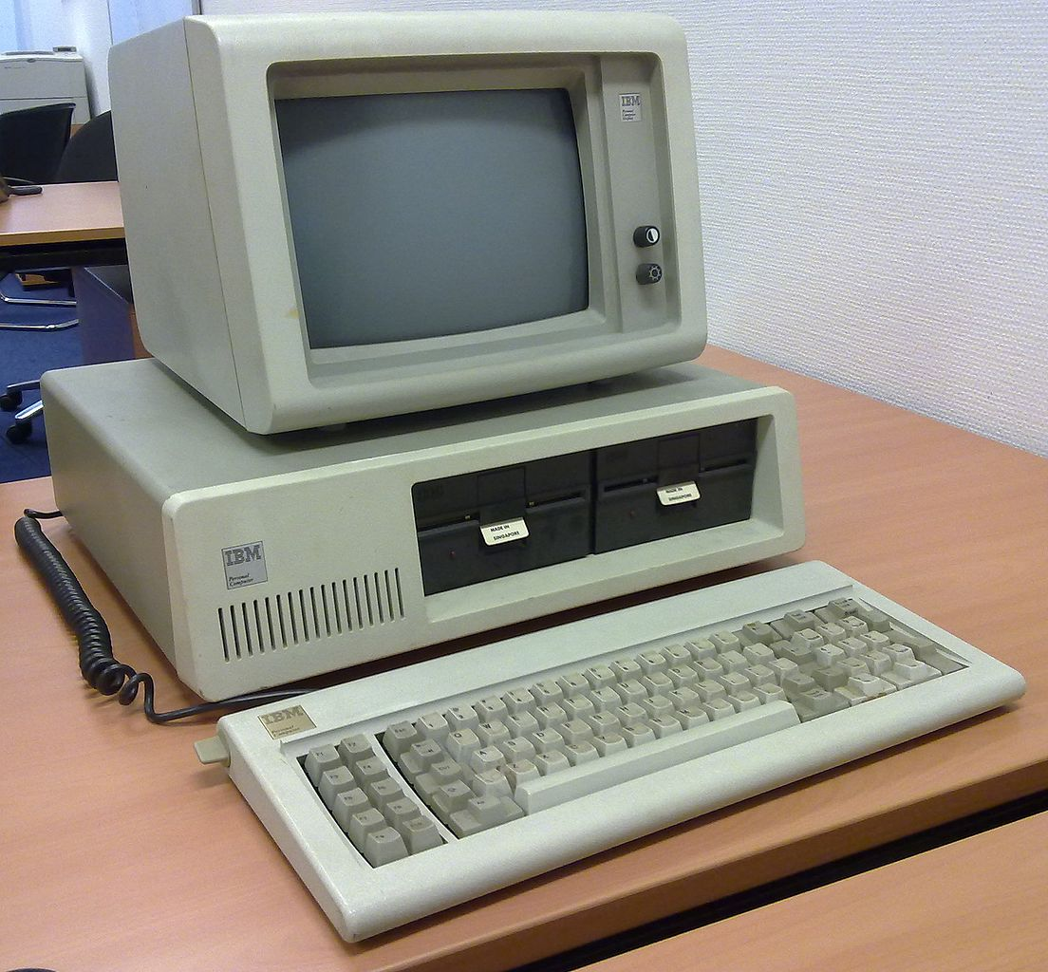
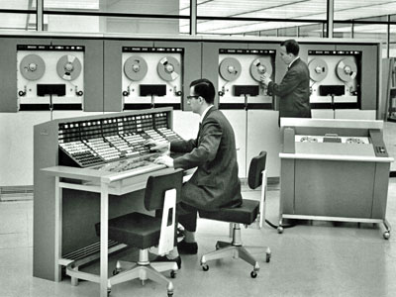
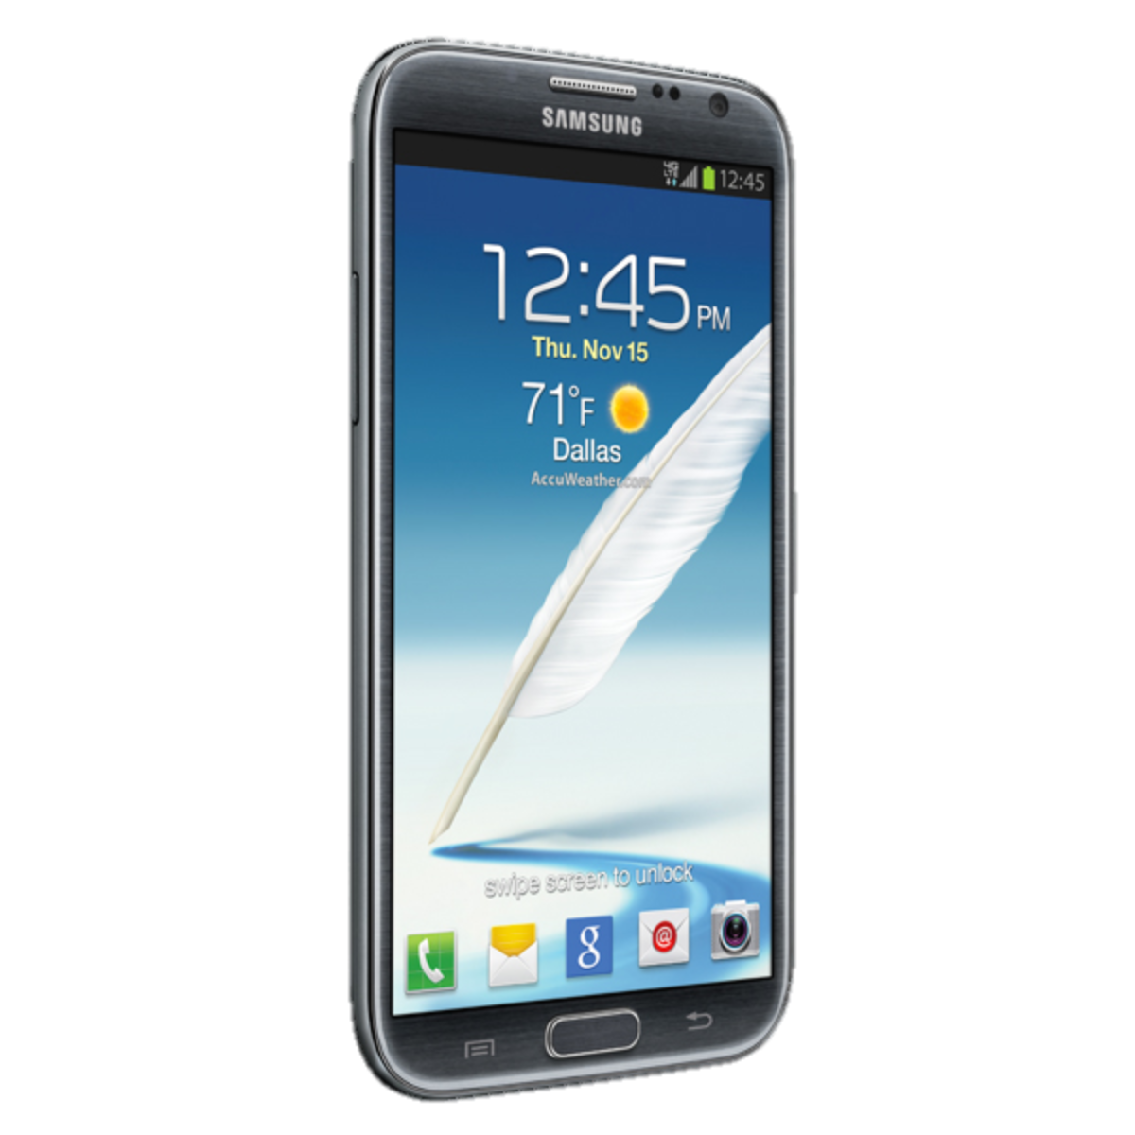
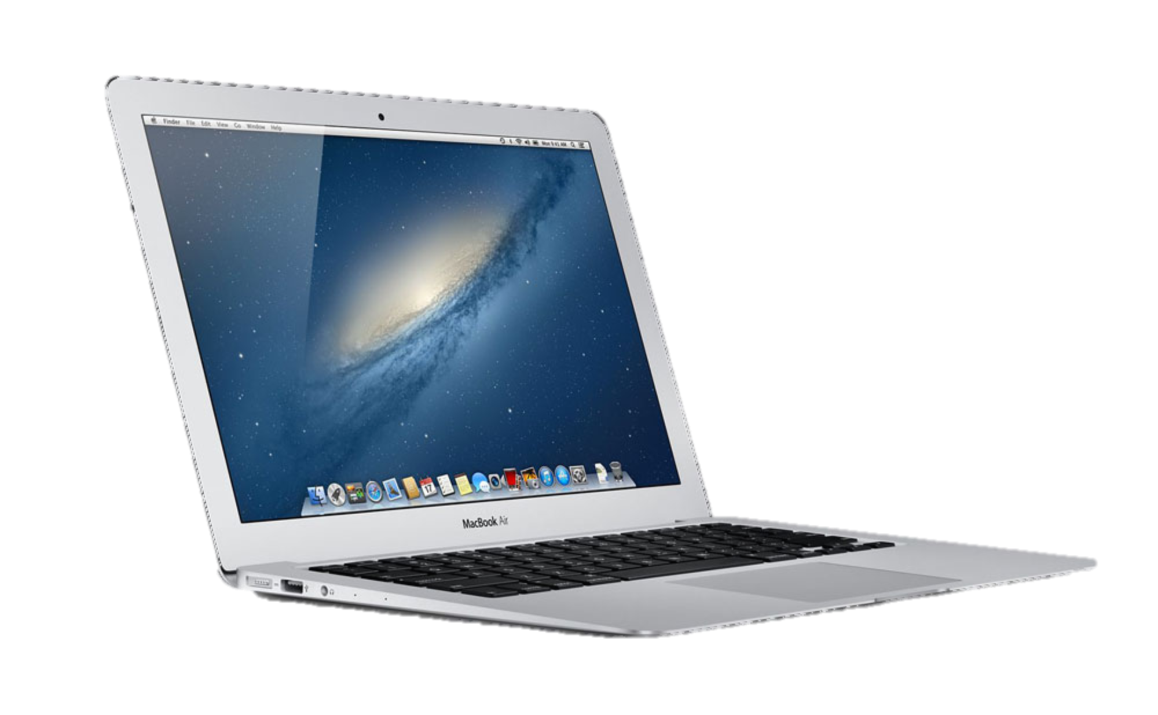
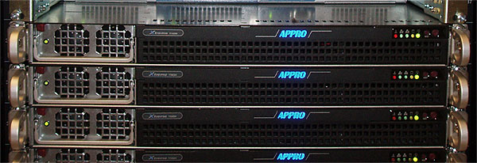
While computers became easier to use and more reliable…
2000s
1960s
Now
1980s
2000s
1960s
Now
1980s

Slide 53
Networks became harder to manage and less reliable…
Now
Now

Slide 54
Making Networks Work (Today)
traceroute, ping, tcpdump, SNMP, Netflow
…. er, that’s about it.

Slide 55
Networks are kept working by
“Masters of Complexity”

Slide 56
Making Chips Work
Formal specification
languages
Specification
Multiple layers of abstraction
Strong foundation (Boolean algebra)
Functional Description (RTL)
Testbench & Vectors
Functional Verification
Logical Synthesis
Dynamic troubleshooting
to Identify root cause
Static checking
of lowest level
design
Static Timing
Place & Route
Design Rule Checking (DRC)
Automatic Test Vector
Generation (ATVG)
Layout vs Schematic (LVS)
Layout Parasitic Extraction (LPE)
Manufacture
& Validate

Slide 57
Making Chips Networks Work
Frenetic, NetCore,
Pyretic, Procera, … [2012]
Formal specification
languages
Policy
Control
Program
Veriflow, NetPlumber [2012]
Control
Plane
Dynamic checking
of lowest level
design
WWW, ndb [2012]
Anteater, HSA [2011]
Dynamic troubleshooting
to Identify root cause
Static checking
of lowest level
design
(several) [2012]
Consistent
Updates
ATPG [2012], NetSONAR [2013]
Automatic Test Pkt
Generation (ATPG)
Packet
Forwarding
NETWORK

Slide 58
Even simple questions are hard
Can host A talk to host B?
What are all the packets from A that can reach B?
Are there any loops in the network?
Is Group X provably isolated from Group Y?
What happens if I remove a line in a config file?

Slide 59
More interesting questions
When I add a new forwarding rule, how can I dynamically check in real-time if it will violate my network policy?
How do I track down the source code that was the root cause of a data plane error?
If switch hardware is malfunctioning, how will I know? How will I identify the switch/rule?

Slide 60
Neither observe nor control
Complex interaction
  Between multiple protocols on a switch/router.
  Between state on different switches/routers.
Multiple uncoordinated writers of state.
Network owner can’t…
  Observe all state.
  Control all state.

Slide 61
Header Space Analysis:
Modeling Forwarding Behavior

Slide 62


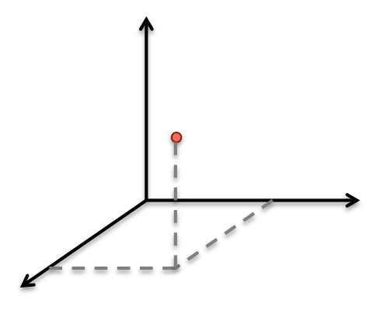
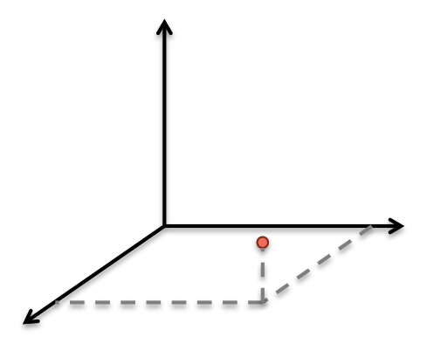
Header Space Analysis
[NSDI ‘12]
A
Header
B
Data
Header
L
Data
01110011…1
111..100000

Slide 63
Header Space Analysis
Match + Action
1
2

Slide 64
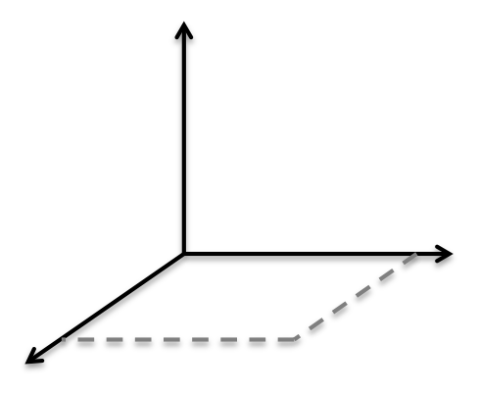

The set of packets from A that can reach B
A
B

Slide 65
All packets from A that can reach B
A
B

Slide 66
Implications
Reachability and loops
Prove two groups are isolated
Regardless of protocol or layer
Analogy to Boolean algebra
Follow-on
  NetPlumber: Dynamic checking Google’s OpenFlow WAN 10,000 times per second
  ATPG: Test every forwarding rule 10-times per second

Slide 67
When we look back in 20 years…
“Software will eat the world”
  SDN and NFV are a natural consequence of a bigger trend.
Network infrastructure will be:
  Baremetal + open-source infrastructure + proprietary apps
Network box vendors will be irrelevant
Network operators will have developed and will own proprietary software
Standards will have diminished value
Networks will be more reliable

Slide 68
<The End>

